Slide 1
Scale-out Data Science with R and Python
John-Mark Agosta, Mario Inchiosa, Tomas Singliar, and Hang Zhang
Microsoft Corporation
Acknowledgements: Jacob Spoelstra
TUTORIAL MATERIAL & SLIDES: https://github.com/microsoft/ICSE2019
ICSE 2019
Montreal, QC
1

Slide 2




Who Are We?
 | John Mark Agosta: leads a team that is expanding the machine learning and artificial intelligence capabilities of Microsoft Azure. joagosta@microsoft.com |  | Dr. Mario Inchiosa: Principal Software Engineer in Microsoft Cloud + AI, where he focuses on delivering advances in scalable advanced analytics, machine learning, and AI. marinch@microsoft.com
 | Tomas Singliar: Principal Data Scientist in the Azure ML group in Microsoft AI Platform's AutoML team. He works on automated search for the best forecasting models. Tomas.Singliar@microsoft.com |  | Dr. Hang Zhang is a Principal Data & Applied Scientist in the Commercial Software Engineering team at Microsoft. hangzh@microsoft.com
2

Slide 3
Tutorial Outline
Create Compute Resources on Azure (15 -30 min)
Create Azure Data Science Virtual Machine (DSVM)
Machine Learning and Data Science Fundamentals (60 min)
Coffee Break (@ 10:30, 30 min)
Scalable Data Science in R using sparklyr (45 min)
AutoML
Lunch break (@ 12:30, 90 min)
AutoML (Cont’d)
Tea Break (@ 3:30, 30 min)
AutoML (Cont’d)
Reinforcement Learning (60 min)
3

Slide 4
Create an Azure DSVM (Ubuntu)
Create a Microsoft account at https://outlook.com (skip if you already have an account @outlook.com, @Hotmail.com, or @live.com)
Use your Microsoft account to get the free Azure subscription https://azure.microsoft.com/en-us/free/
You get 200$ Azure credits expiring in 30 days
Credit card needed for identification purpose. You will not be charged even after 30 days or the 200$ credits are used
Create an Ubuntu DSVM https://docs.microsoft.com/en-us/azure/machine-learning/data-science-virtual-machine/dsvm-ubuntu-intro (search for Data Science Virtual Machine)
Create an AzureML workspace https://docs.microsoft.com/en-us/azure/machine-learning/service/setup-create-workspace#portal (Search for workspace, and choose machine learning service workspace)
Install x2go client on your local machine https://wiki.x2go.org/doku.php/doc:installation:x2goclient
Mac users might need to log out and log in to make x2go client work
Test connecting to your DSVM
Go to Azure portal to get the public IP of your DSVM
Connect to it from x2go client by choosing XFCE
After connecting, open a command window in x2go client, and clone the github repository to get the tutorial content to your DSVM:
cd notebooks
git clone https://github.com/microsoft/ICSE2019

Slide 5
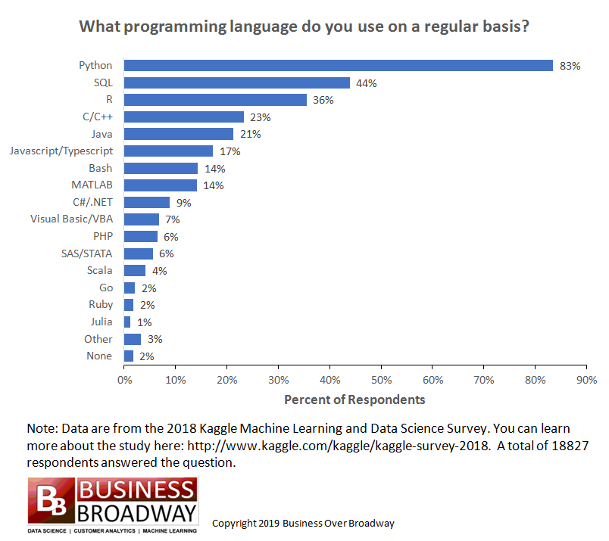
Popular Languages in Data Science
5

Slide 6

Language
Platform
A language and environment for stat computing and graphics
What is
A data visualization tool
Open source
2.5+M users
Community
Taught in most universities
Many common use cases across industry
Thriving user groups worldwide
5th in 2016 IEEE Spectrum rank
42% pro analysts prefer R (highest amongst R, SAS, python)
Ecosystem
10,000+ contributed packages
Rich application & platform integration
6

Slide 7

Language
Platform
A language for multiple purpose (Web, GUI, Scripting, etc.)
What is
Object Oriented
Open source, cross platform
Focus on readability and productivity
Community
8.2+M users*
69% machine learning developers and data scientists use Python *
Ecosystem
180,000+ packages (based on pypi.org)
2,000 new packages added every month
*: Programming languages: Python developers now outnumber Java ones. By Liam Tung, ZDNet, April 15, 2019
7

Slide 8
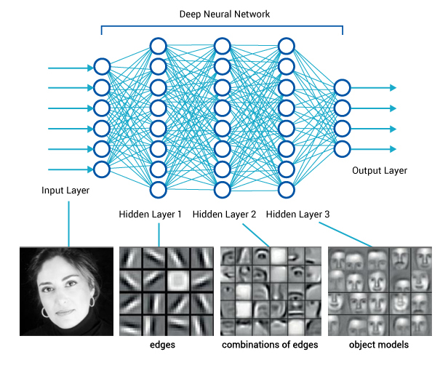
The 4th Industrial Revolution
AI
Big Data and IoT
Cloud Computing
Source：www.britannica.com

Slide 9
The opportunity is bigger than you may think
Diverse
data
$1.6T
New
@
How?
analytics
speed
data dividend available to businesses that embrace data over the next four years
More
people
Data source: Microsoft and IDC, April 2014
Notes:
Clearly companies are using analytics to change the game and status quo.
We are making a lot of investments to enable you our partners help our customers take advantage of analytics much more effortlessly and more much more effectively.
Key Points:
Companies that make best use of data and analytics investments stand to capture more value compared to companies that do not
Data is the new currency—the formula is relatively simple as to how we get our returns on data
When we talk about a diverse data, it’s important to think about all of the data that is generated by apps, stored in apps, and spun off from apps as data exhaust.
Talk Track:
If data is the new competitive advantage for business, we want to get granular and specific on how companies can derive business value.
IDC explored the impact of data on business. After surveying more than 2,000 companies, IDC found that there are two categories of businesses: organizations that have taken a leadership position when it comes to data; and those that are not making best use of data. We learned that the leaders—those companies that embraced data—derived significantly more dividends from those investments in data—from increased revenue, improved productivity, and reduced costs.
There is a unique formula that drives this notion of data dividends, or return on data. Data-driven companies focus on several areas:
Capturing diverse data: You can no longer just think about what to do with traditional data types. You need to be open to and capable of collecting a wide array of data—including new data types.
Utilize new analytics: Logical data warehouses are no longer going to extract and transform new data types. You need to explore new analytical capabilities that are suited to new data types and real-time decision making needs.
Deliver to more people: To unlock insights, you need to democratize your data across the organization.
Uncover real-time insights: With the rise of the Internet of Things, and the instrumentation of just about everything, the ability to provide real-time visibility across lines of business represents a big value opportunity.
At the worldwide level, leaders will capture $1.6 trillion more in value from their data and analytics investments over the next four years compared to companies that don’t. This represents a 6 percent higher data dividend for leaders—an opportunity that exists for any individual organization looking to maximize its return on data assets and reap ongoing data dividends.
When we talk about a diverse data, it’s important to think about all of the data that is generated by apps, stored in apps, and spun off from apps as data exhaust.

Slide 10
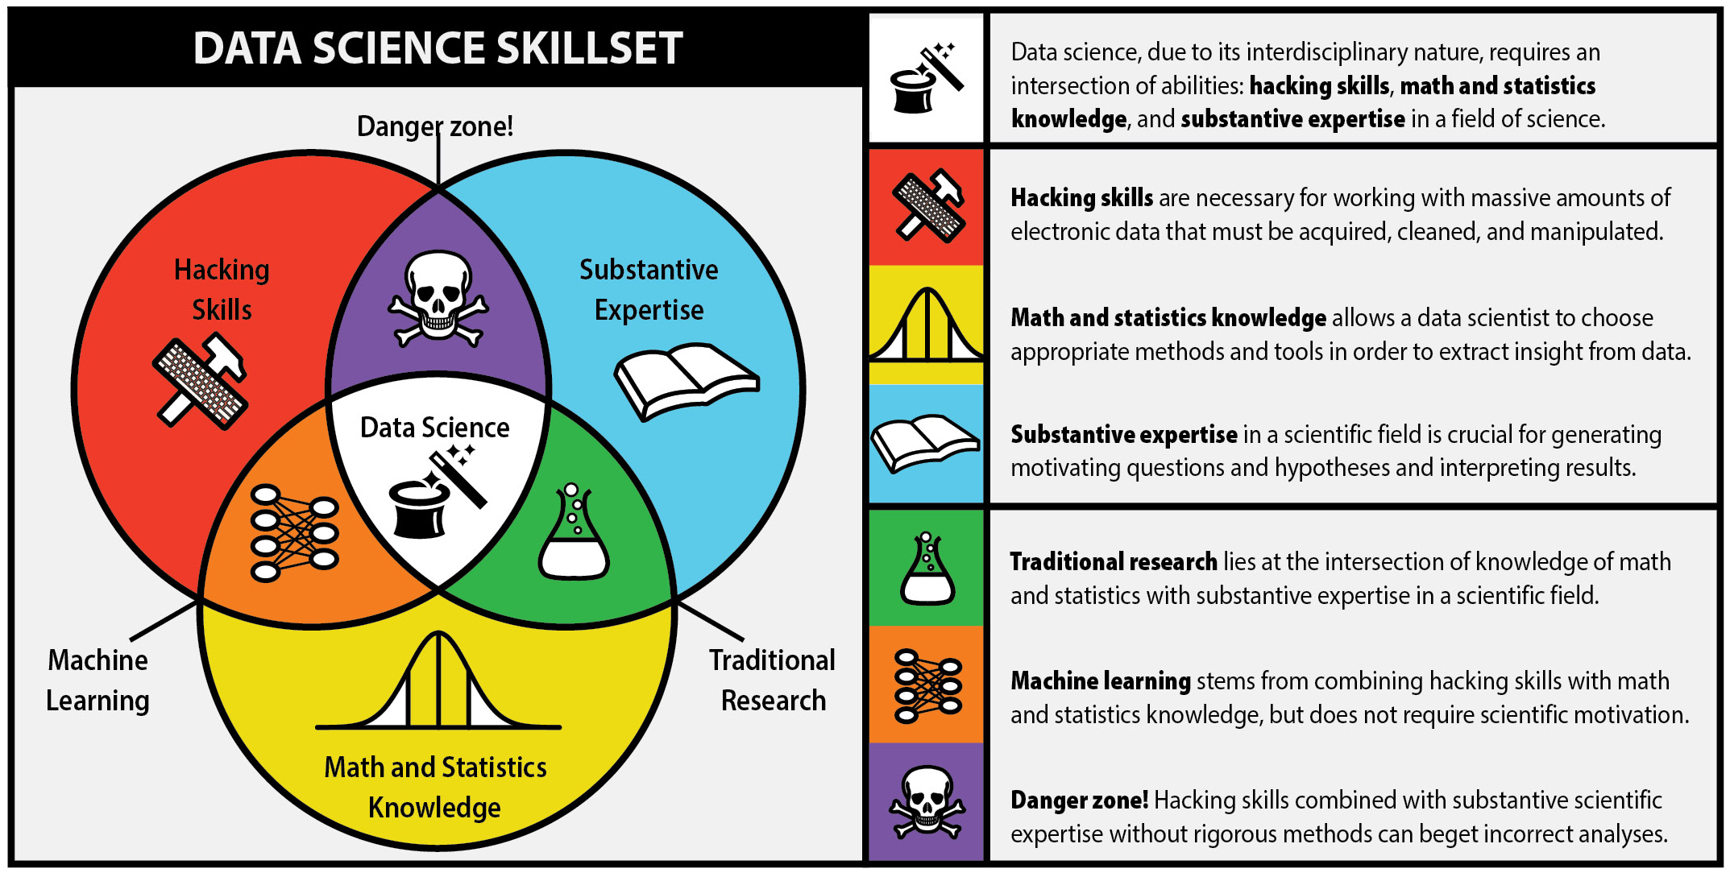
Courtesy: Steve Geringer. http://www.anlytcs.com/2014/01/data-science-venn-diagram-v20.html
Source: http://berkeleysciencereview.com/how-to-become-a-data-scientist-before-you-graduate/
Notes:
Data Science is a discipline that requires several skills. Traditionally it has been considered as the intersection bewtween math/stats, software engineering and domain expertise. Many companies have realized that that is like looking for unicorns. It is one of the hardest position to fill industry wide and especially when companies continue to believe in unicorns. As per this definition data science was expanded to include a whole combination of math/stats, computing and business expertise. Math/statistics is still a pretty core aspect. But with the explosion of computing and data, new methods of analysis are needed to deal with data at large. This requires enhanced software engineering skills. Lastly the deep domain knowledge is needed to create data products that customers will actually love and vote with their dollars.
Inspired by a few leaders that were able to make data at the core of their competitive advantage, businesses in various industries had started building some very useful data applications. Normally they did this by hiring people of different skills and assembling a team with these folks to cover all the key skills needed for successful data science.

Slide 11
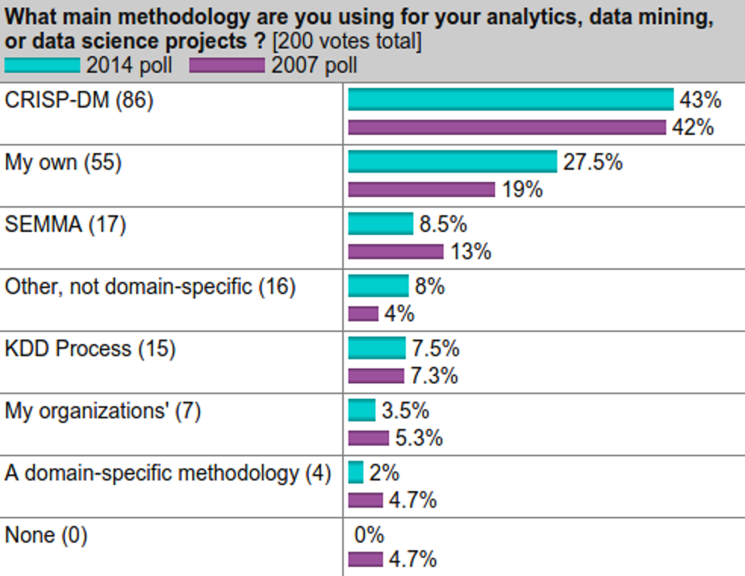
What Is THE Standard Process for Data Science?
Source: KDD Nuggets, October 2014
Notes:
A 2014 KDD Nuggets survey found that it is still the most popular, although more folks are using their own process. Noteworthy was that nobody does not use some process.
… Let’s look at CRISP-DM…

Slide 12
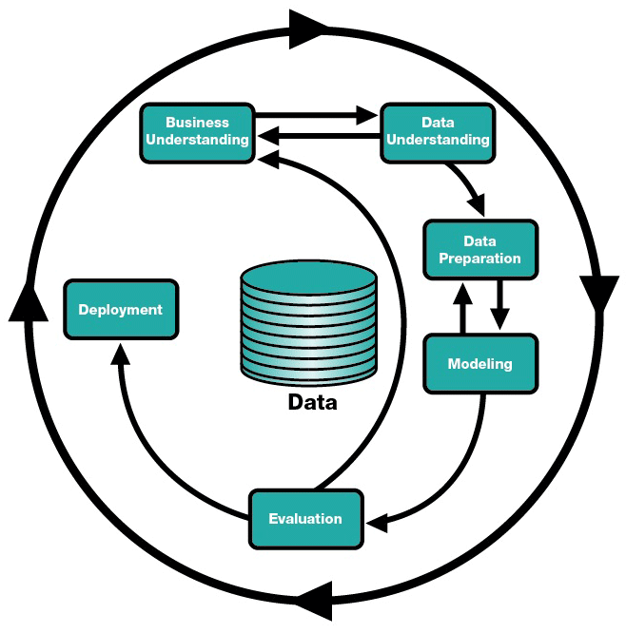
Notes:
Similar to CRISP-DM, defines the stages of a project, but acknowledges the tight integration of both data and modeling sub-processes. These are the granularity that we’ve found practical to track and report.

Slide 13



Data

Slide 14



Data

Slide 15


Data

Slide 16


Data

Slide 17
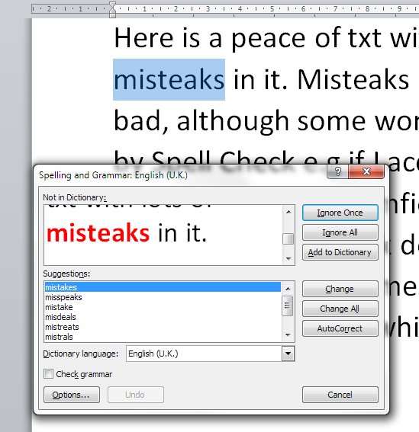
Artificial Intelligence
Machine Learning
Deep Learning

Slide 18
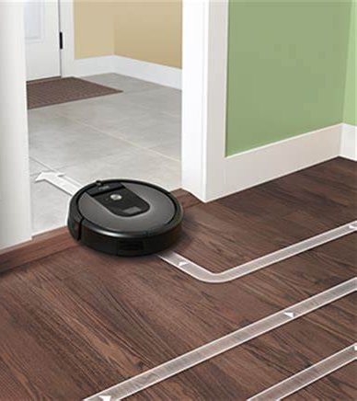
Artificial Intelligence
Machine Learning
Deep Learning

Slide 19

Artificial Intelligence
Machine Learning
Deep Learning
Layers of functions calculating patterns

Slide 20
Types of Machine Learning Problems
Supervised learning: You have a set of independent variables X, and a target variable Y. Your machine learning task is to build a map from X → Y.
Classification and regression models both belong to supervised learning
Unsupervised learning (clustering)
Class labels of the data are unknown
Given a set of data, the task is to establish the existence of classes or clusters in the data

Slide 21
Examples of Supervised Machine Learning Problems
Fraud transaction: determine which transactions are fraud (1), which are not (0)
Readmission: predict whether a patient is going to be readmitted to hospital within a certain time window after discharge
Recommendation: predict which items a customer is going to buy based on his and other customers’ purchasing history.
Forecasting: forecast the sales, demand, energy consumption, …, in the next month/week/day/hour

Slide 22
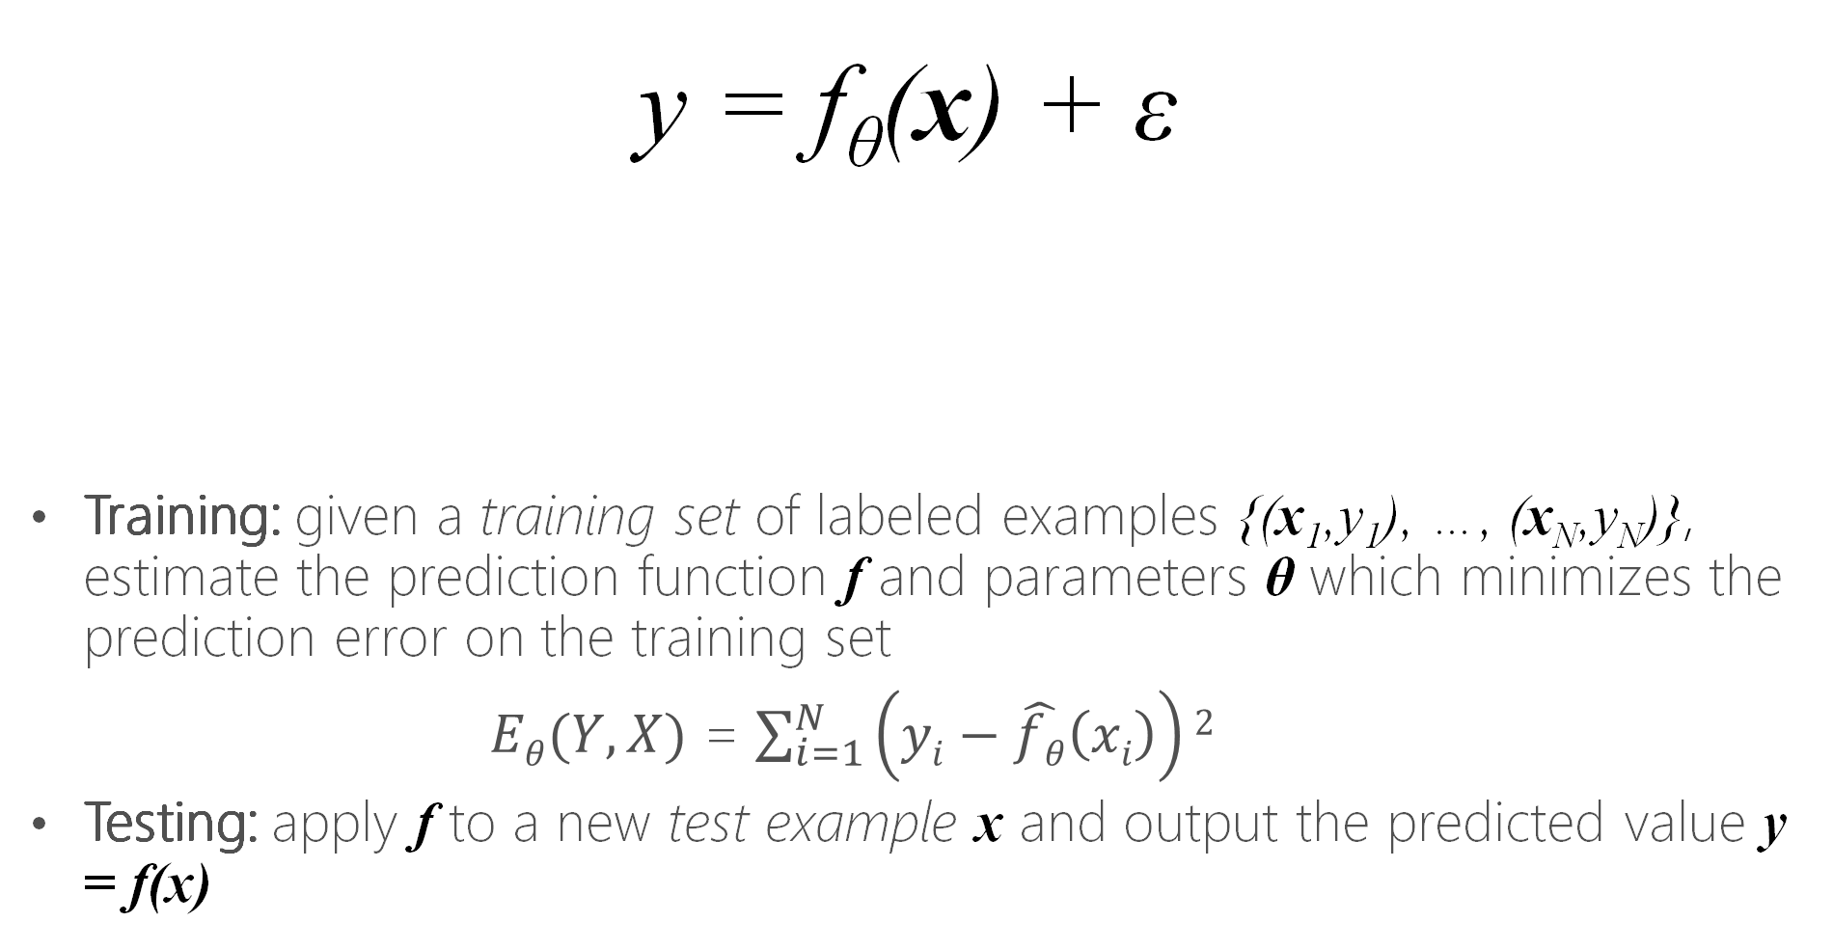
Supervised Machine Learning Framework
y = f_{θ}(x) + ε
Training: given a training set of labeled examples {(x₁,y₁), …, (x_{N},y_{N})}, estimate the prediction function f and parameters θ which minimizes the prediction error on the training set
$Eθ(Y,X)$ = $\sum_{i=1}^{N}{\left(yi−\hat{fθ}\left(xi\right)\right)2}$
Testing: apply f to a new test example x and output the predicted value y = f(x)
Observed
dependent
variable
prediction function
Independent variables
Random noise
Notes:
In general, in machine learning, the observed target variable can be expressed as a function of a set of observed independent variables, plus some measurement random noise. The function f has some hyperparameters theta. The training process is that based on a set of N observations where both independent and target variables are observed, we need to estimate the format of the function, and the values of the hyperparameters such that the model can predict the target values of the training data as close as to the observed values.
Therefore, in machine learning, if we fix the format of the function, we are looking for the values of the hyperparameters such that a loss function, which usually is the sum of square errors, can be minimized.
After the model is trained, at the testing stage, we are applying this trained model to predict the target variable on a set of test examples which have not been seen by the training process.

Slide 23
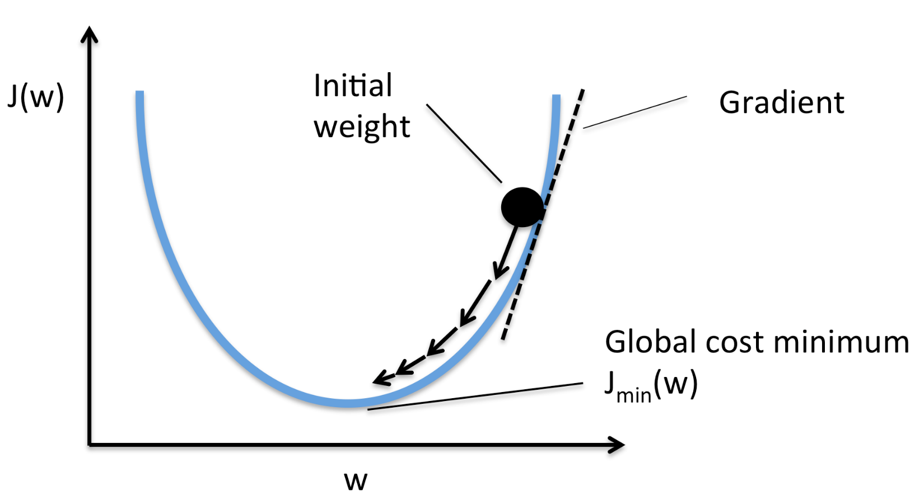
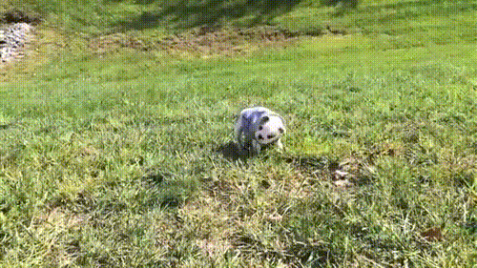

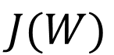
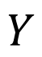

How to learn model parameters θ?
F(x, W)
$$X$$
$$Y$$
$$\hat{Y}$$
$$J(W)$$
Notes:
This picture depicts the framework of training a machine learning model. Here, the model is shown as a black box. An observed independent vector is passed through the black box, which generates an estimation of the target variable Y_hat. Then, this estimation is compared with the true value of target variable, and a loss is generated.
Stochastic gradient descent is one of the most popular algorithm to seek for the optimal values of the hyperparameters.. It starts with a random guess of the hyperparameters. Every time, it only adjust a small step towards the opposite direction of the slope (tangent) on that current estimates. Gradually, it will reach a minimal (global or local) of the loss function.

Slide 24
Hands on Lab 1: Data Science and Machine Learning Fundamentals
In x2go client, open a browser and visit https://localhost:8000
Choose advanced when security warning pops up
Log in using your user name and password when you created the VM
Run the codes with the speaker

Slide 25
3 Deterministic Factors of A Machine Learning Model
Training Features
A set of variables that are generated from the raw data and are used to train the model
Model
Linear regression model, decision tree model, random forest model, etc.
Hyperparameters of the model
E.g., Random Forest model, how many trees, maximal depth of each tree, minimal number of observations in each leaf node
E.g., artificial neural network model, number of hidden layers, how many hidden nodes, activation function, learning rate, random seed

Slide 26
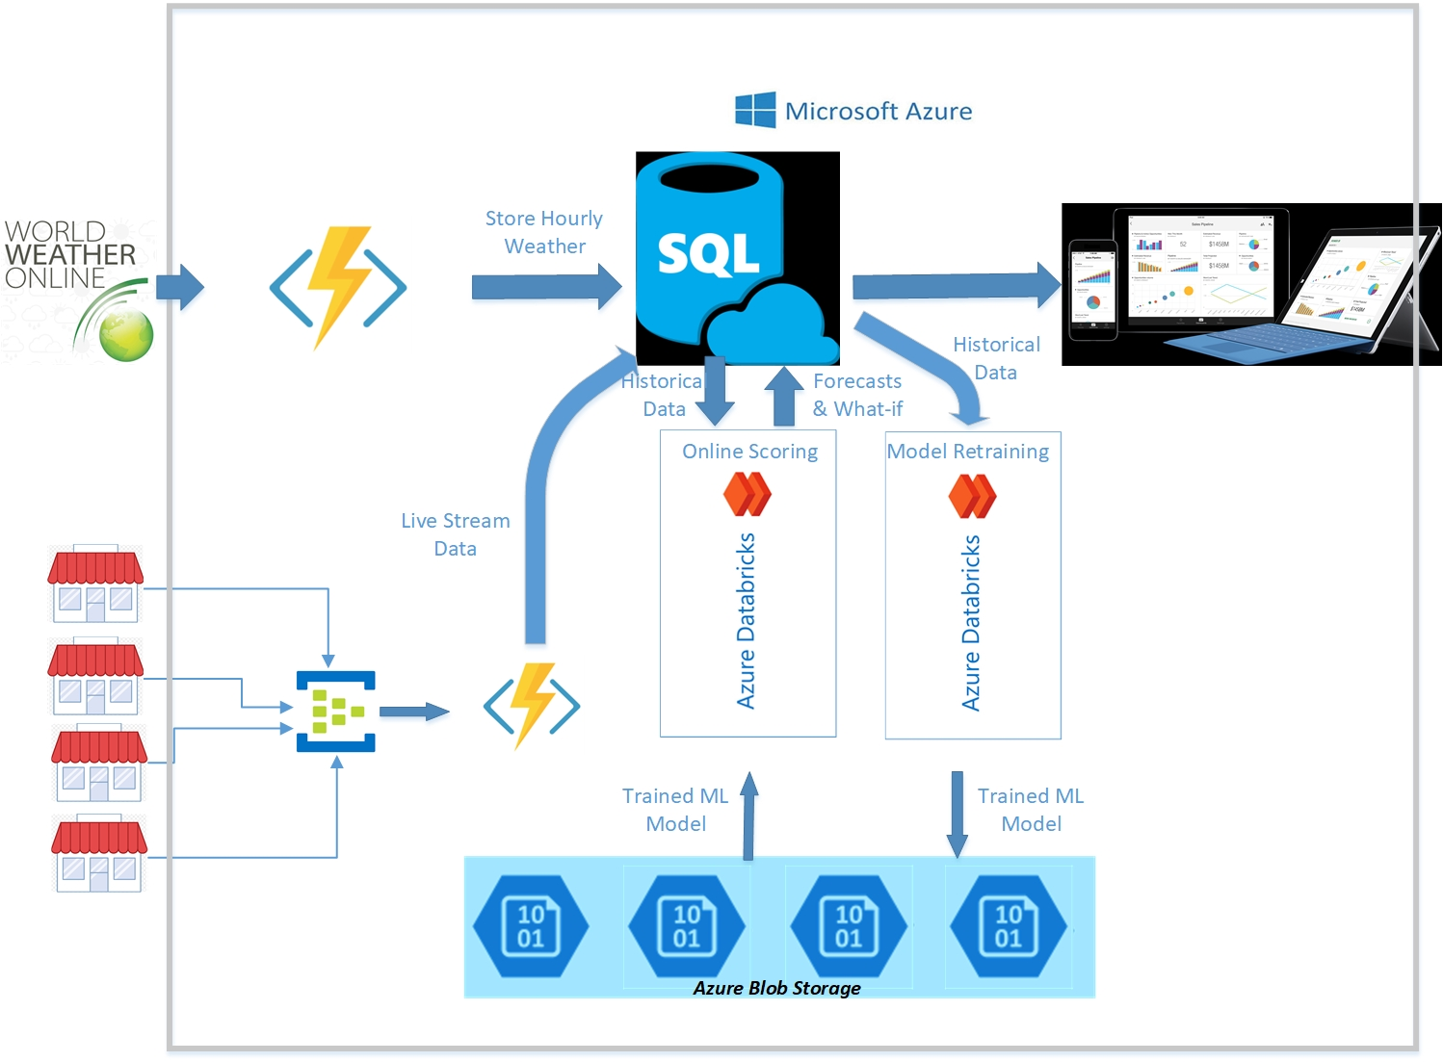
Bring AI to Your Big Data: Big Data IoT and PySpark ML
Stores, Edge Devices

Slide 27
Predictive Analytics and Prescriptive Analysis
Predictive analytics:
Assuming that we have trained a model Y=f(X)
Now, given X, what will be the predicted value of Y
Prescriptive Analysis:
Assuming that we have trained a model Y=f(X)
Now, given X, what will be the predicted value of Y if I change X to X + ∆X, i.e., Y=f(X+ ∆X)
Then, choose the optimal ∆X that can reach my desired Y
Examples:
How I should change the fridge temperature setting in my grocery store so that I can reduce my energy consumption by ∆ kW.
How much price discount I should offer so that my sales can increase 20% next month?

Slide 28






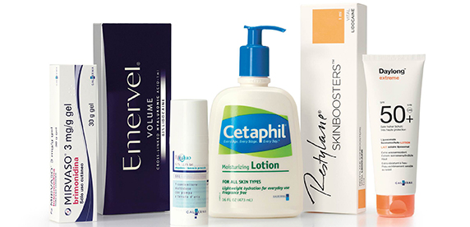
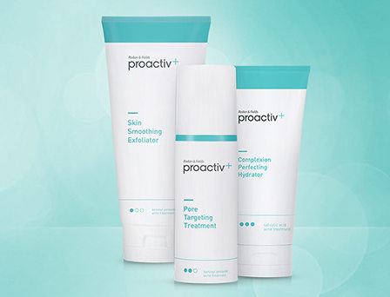
Bring AI to Your Customers: Nestle
Notes:
Acne is the most common skin condition in the United States. Not just teens have acne, a growing number of women have acne in their 30s, 40s, 50s, and beyond. Nestle Skin Health (NSH) is the skin care institute of Nestle, which has multiple skin care products under the brands such as Cetaphil and Proactiv.In this application, NSH was working with Microsoft to develop a mobile app for their customers to assess the severity level of acne by evaluating the selfie photos using deep learning models operationalized on Azure Container Services. The ultimate objective of this application is to recommend skin care products to their customers based on the predicted severity level, and other demographical information such as gender, age, race, etc, and track their progress of curing acne by using the recommended products.

Slide 29

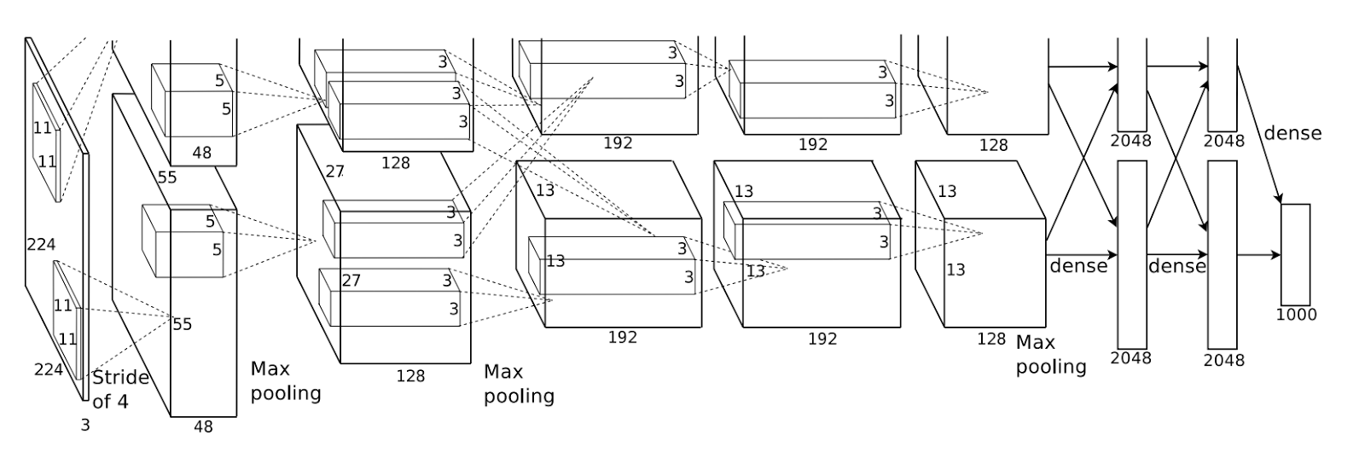

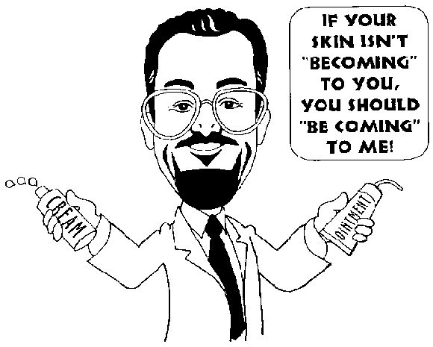

Application Scenario 1: Assessment
Clear/Almost Clear/ Mild/Moderate/Severe
Severity level
☺: Clear
Severe
No
Almost Clear, Mild, Moderate?
Yes
Age/Gender/Race
Skin type
NSH products on market

Slide 30



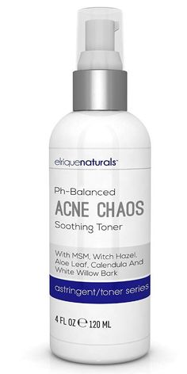

Application Scenario 2: Progress Tracking
Severity Level
Severe
Moderate
Mild
Clear
Day 1
Day 2
Day 7
Day 10
Day 21
Day

Slide 31
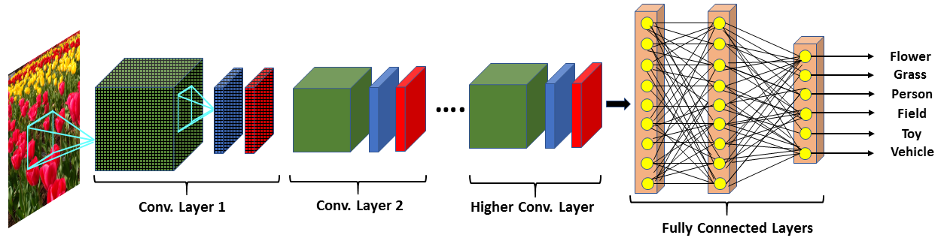
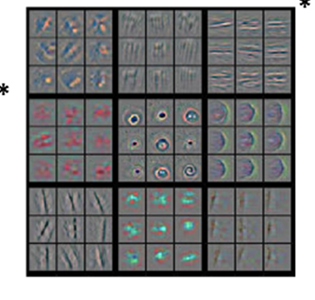
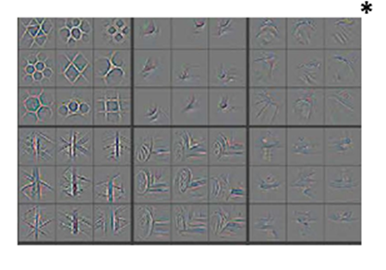
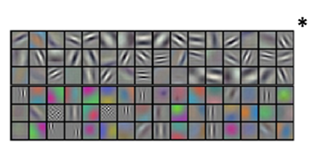
Convolution Neural Network Framework
Convolution
Response
Norm.
Pooling
* Feature visualization images from “Visualizing and Understanding Convolutional Neural Networks”, Zeiler and Fergus, ECCV 2014.

Slide 32
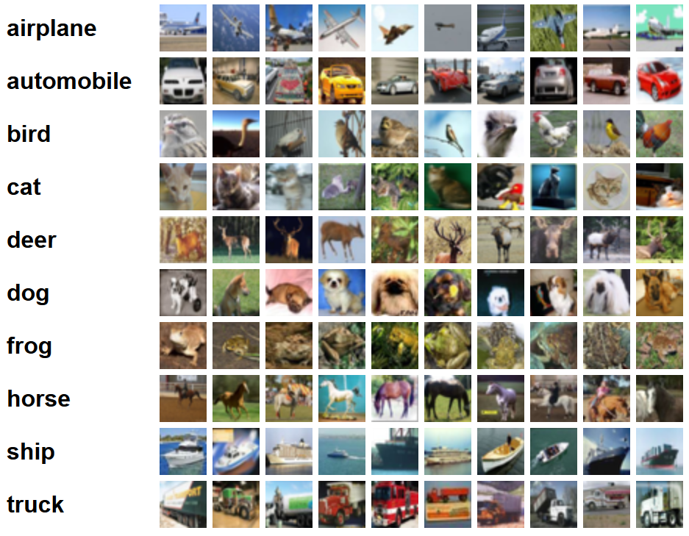
Most Popular Pre-trained Image Classification CNN Models
ResNet CNN (source here)
Inception CNN (source here)
VGGNet
AlexNet
All trained on 1.2M images of CIFAR on 1000 classes of objects
source: https://www.cs.toronto.edu/~kriz/cifar.html

Slide 33
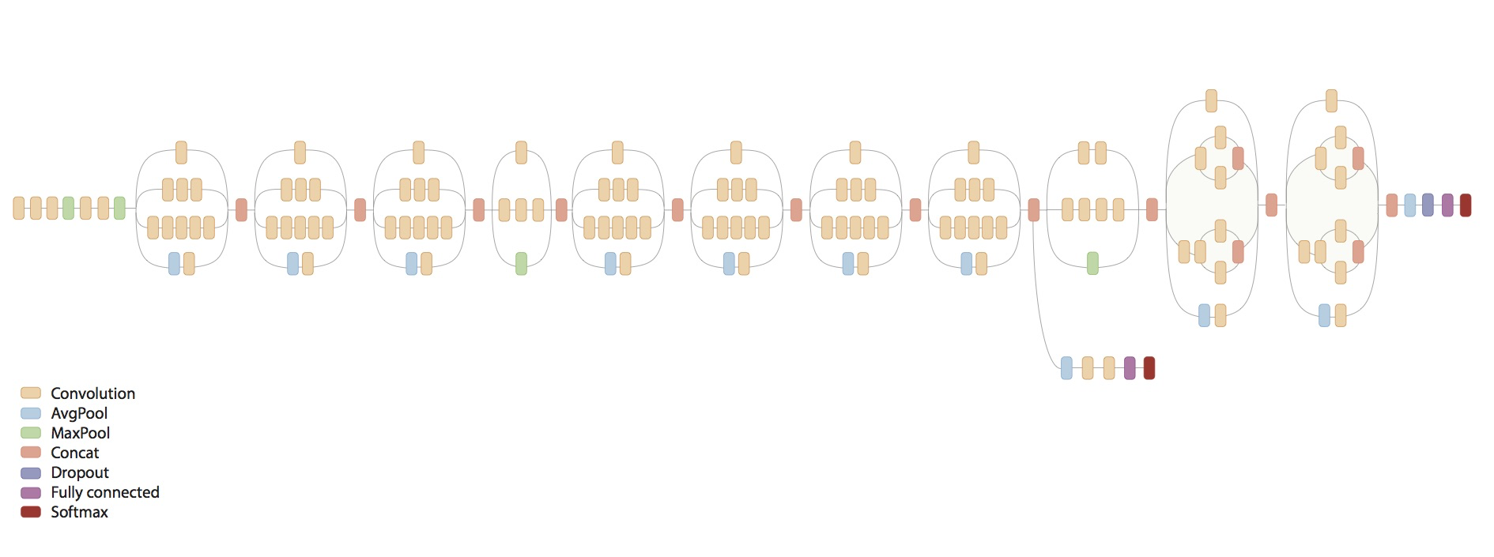

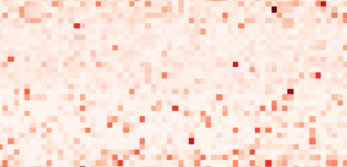
Transfer Learning
ResNet 152 pre-trained model
Feature Extractor
Fully connected Neural Network Model
Image Score

Slide 34
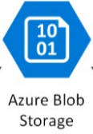


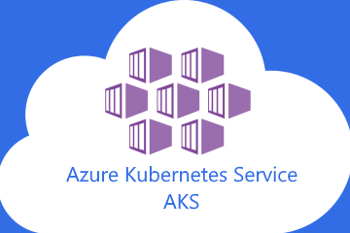
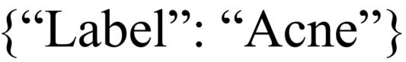



Architecture

Slide 35

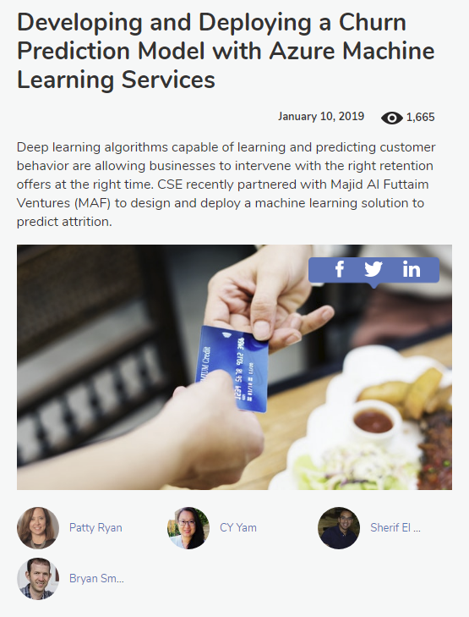
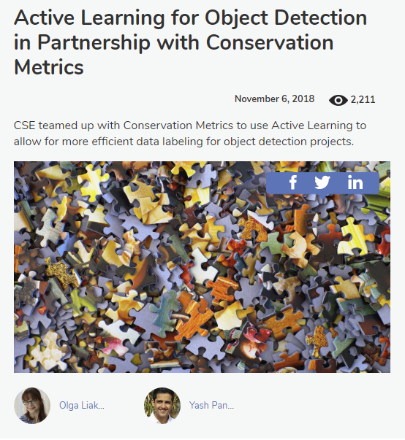
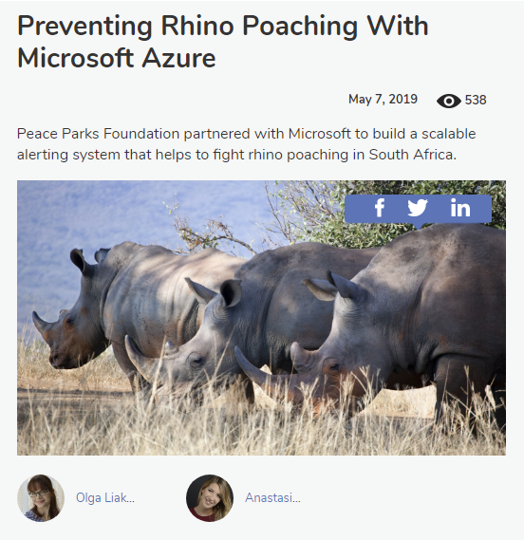
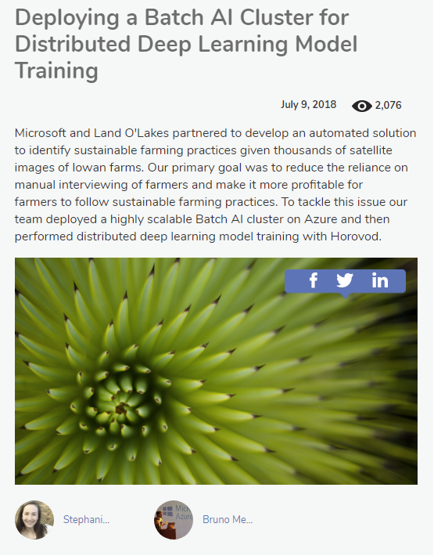
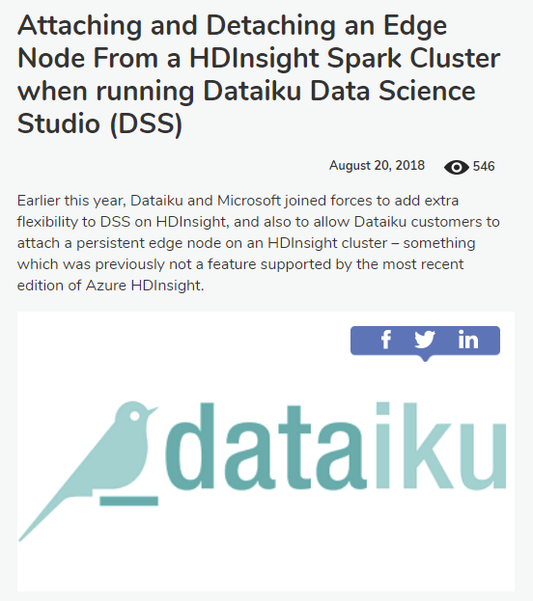
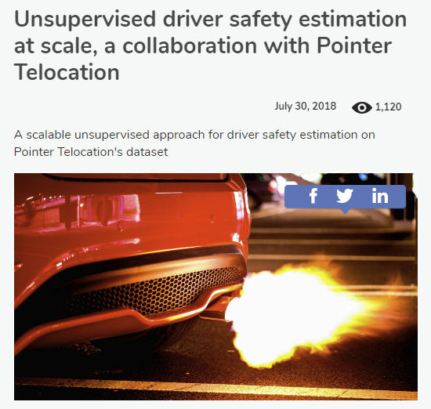
Example Projects We Coded with External Partners

Slide 36
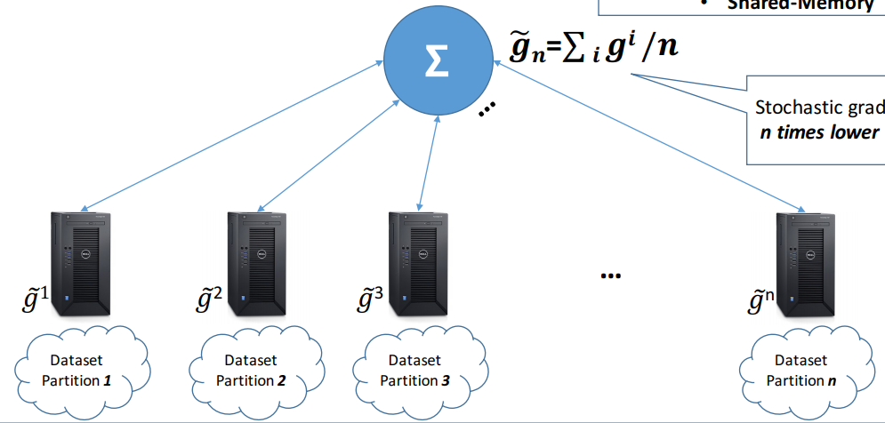

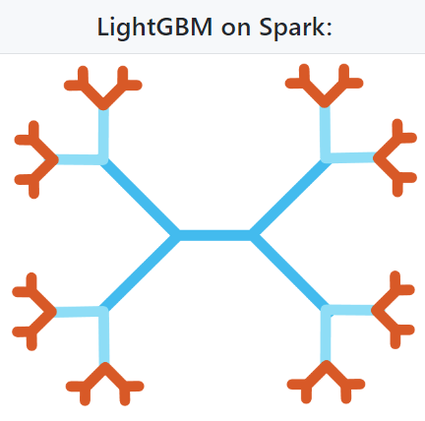
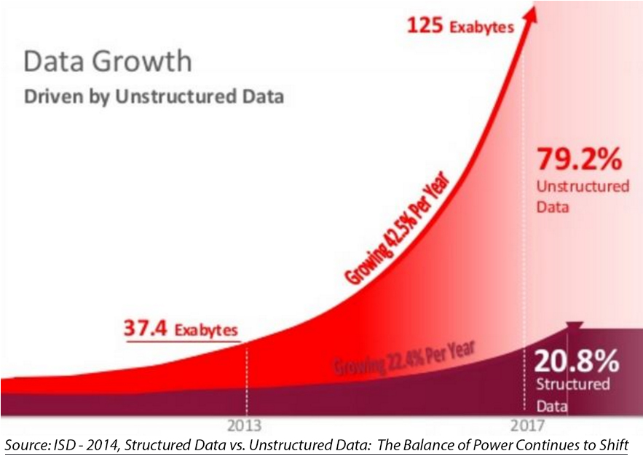
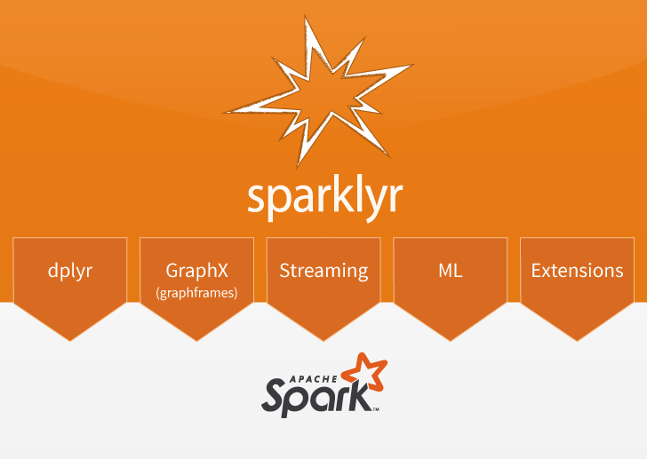

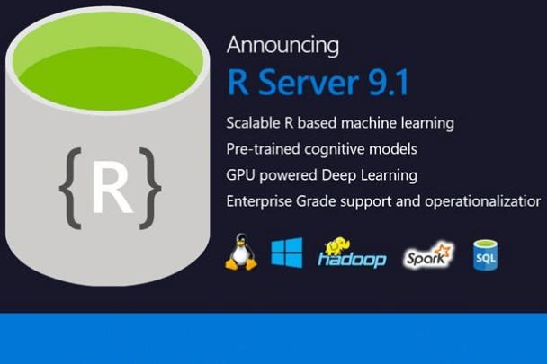
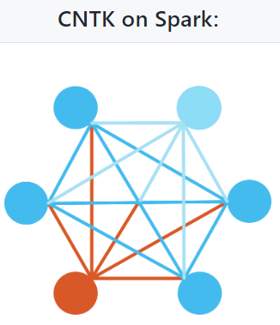


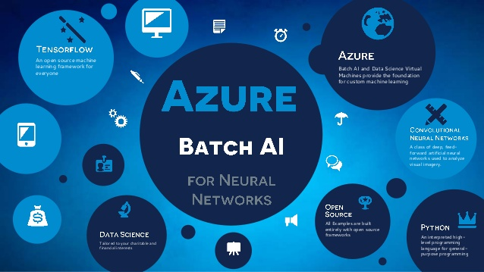
Challenges of Big Data to Data Scientists
AI
Exponentially Growing Big Data
“Unlimited” Cloud Computing
Source：www.britannica.com
https://www.podc.org/data/podc2018/podc2018-tutorial-alistarh.pdf

Slide 37


Slide 38

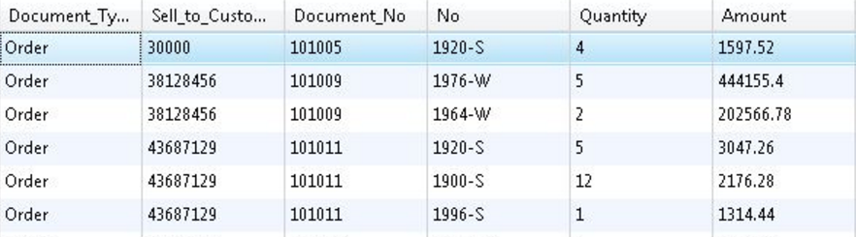
Challenges with Scaling R
Data Movement
Moving data from the database to the R Runtime becomes painful as data volumes grow and carries security risks
..........
Scale/Performance
Base R runs single threaded and only accommodates datasets that fit into available memory

Slide 39
Scalable Open Source R Solutions
R packages for scaling on single machines
The bigmemory project
ff and related packages
foreach with doParallel
R packages for scaling with distributed computing
SparkR
sparklyr
h2o,rsparkling
foreach with doAzureParallel, doSNOW
39

Slide 40
Distributed computing on Spark
Brief intro to Spark, its APIs and OS R packages
40

Slide 41
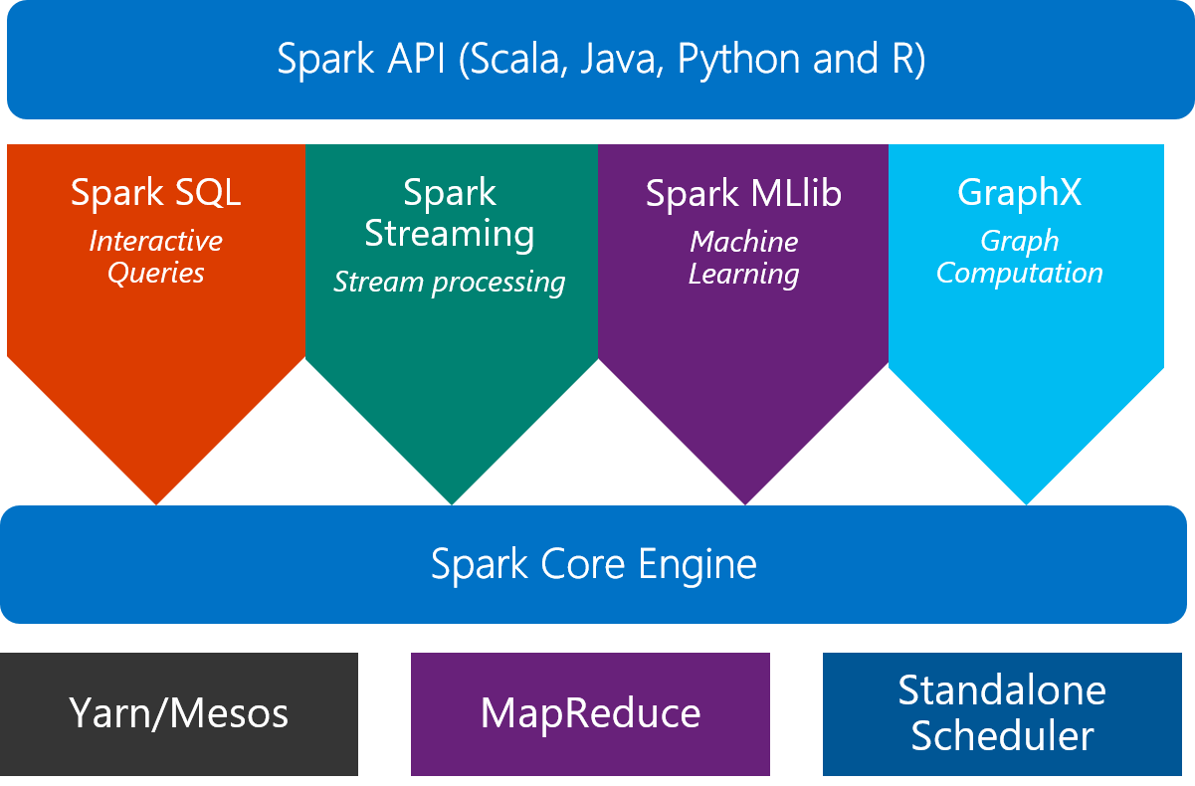
Scaling R on Spark Clusters
What is Spark?
An unified, open source, parallel, data processing framework for Big Data Analytics
Local
41

Slide 42

SparkR: R API included with Apache Spark
An R package provides a light-weight frontend to use Apache Spark from R and allows data scientists to analyze large datasets.
SparkDataFrame is distributed collection of data organized into named columns.
SparkR can create SparkDataFrames from local R data frames, csv, json and parquet files.
Access tables from Hive MetaStore.
Pre-configured on Spark clusters in Azure HDInsight and Azure Databricks
42

Slide 43
Data processing and modeling with SparkR
Supports functions for processing structured data
Selections: select(), filter()
Grouping, Aggregations: summarize(), arrange()
Running local R functions distributed: spark.lapply()
Applying UDFs on each partition/group of a SparkDataFrame: dapply(), dapplyCollect(), gapply(), gapplyCollect()
Uses MLlib to train models and allows model persistence
Generalized Linear Model
Survival regression
Naive Bayes
KMeans
Logistic Regression
Gradient Boosted Tree
Random Forest
… others
43

Slide 44
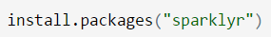
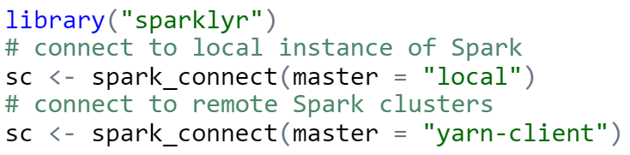
sparklyr: R interface for Apache Spark
Easy installation from CRAN
Connect to both local instances of Spark and remote Spark clusters
Loads data into SparkDataFrame from: local R data frames, Hive tables, CSV, JSON, and Parquet files.
Source: http://spark.rstudio.com/
44

Slide 45
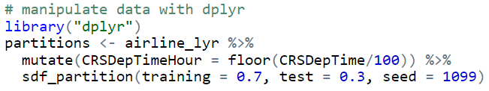
dplyr and ML in sparklyr
Provides a complete dplyr backend for data manipulation, analysis and visualization
%>%
Includes 3 family of functions for machine learning pipeline
ml_*: Machine learning algorithms for analyzing data provided by the spark.ml package.
K-Means, GLM, LR, Survival Regression, DT, RF, GBT, PCA, Naive-Bayes, Multilayer Perceptron, LDA
ft_*: Feature transformers for manipulating individual features.
sdf_*: Functions for manipulating SparkDataFrames.
45

Slide 46
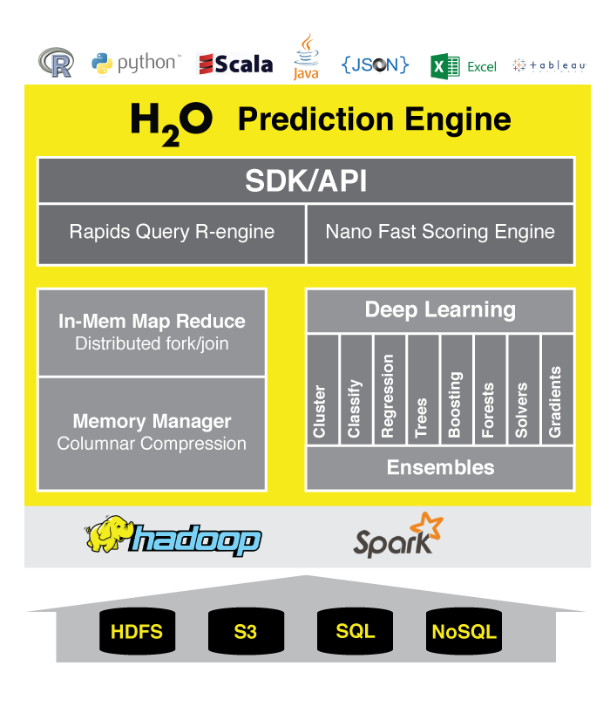
h2o: prediction engine in R
Optimized for “in memory” processing of distributed, parallel machine learning algorithms on clusters.
Data manipulation and modeling on H2OFrame: R functions + h2o pre-fixed functions.
Transformations: h2o.group_by(), h2o.impute()
Statistics: h2o.summary(), h2o.quantile(), h2o.mean()
Algorithms: h2o.glm(), h2o.naiveBayes(), h2o.deeplearning(), h2o.kmeans()
rsparkling package: h2o on Spark
Provides bindings to h2o’s machine learning algorithms
Simple data conversion: SparkDataFrame -> H2OFrame
http://www.h2o.ai/product/
46

Slide 47
Hands-on Tutorial: sparklyr
Launch X2go Client and click Session | New Session
Host: enter host IP address
Login: enter username
Session type: choose XFCE
Click OK
Click the icon or the session name, e.g. “New session”
Enter password
Click OK
Open command window on DSVM and execute “docker run” command:
sudo docker run -e PASSWORD=mypassword1 -p 8787:8787 rocker/verse
Open web browser on DSVM and connect to RStudio Server on port 8787:
http://localhost:8787
Open terminal window in RStudio and clone git repo
git clone https://github.com/microsoft/ICSE2019
In the Files pane in RStudio,
Open the ICSE2019 folder
Open the R folder
Click 1-Intro-Transform-Train-Score.Rmd (not the .nb.html file)

Slide 48
Q & A
48

Slide 49
THANK YOU

